Slide 1
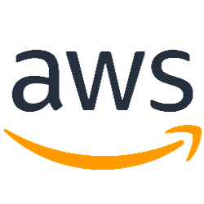
Amazon virtual private cloud (VPC) Topic: 3 Create by: MaiLT - Team 1 Date: 22/5/2019

Slide 2
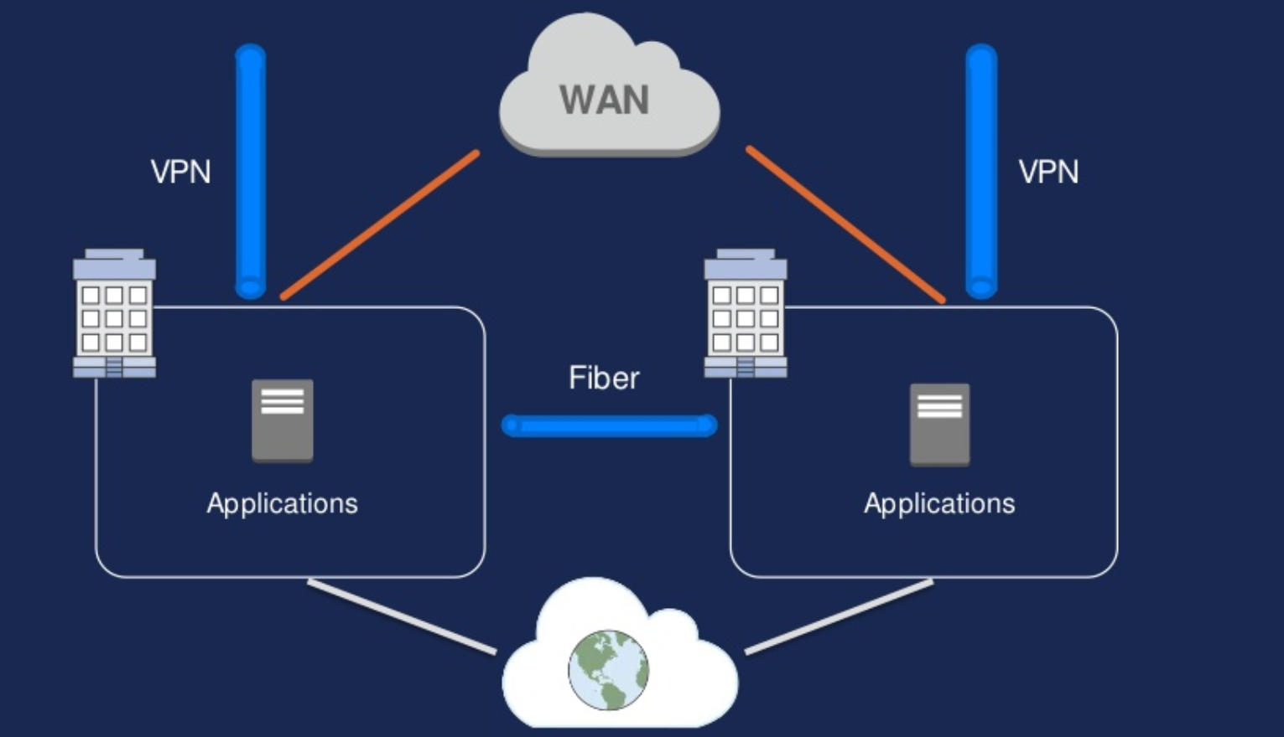
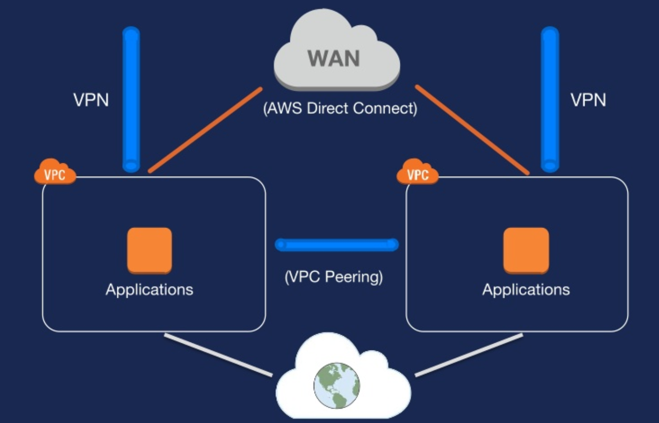
INTRODUCTION
Traditional network
AWS network

Slide 3
This topic will cover to:
Fundamentals:
VPC Overview
Picking you IP space
Subnet design
Routing and NATing
VPC Security
Advanced topic:
VPC Peering
VPC Flow Logging
VPC Endpoints
DC Connectivity:
IPsec VPN Tunnel
AWS Direct Connect

Slide 4
AWS VPC Overview

Slide 5

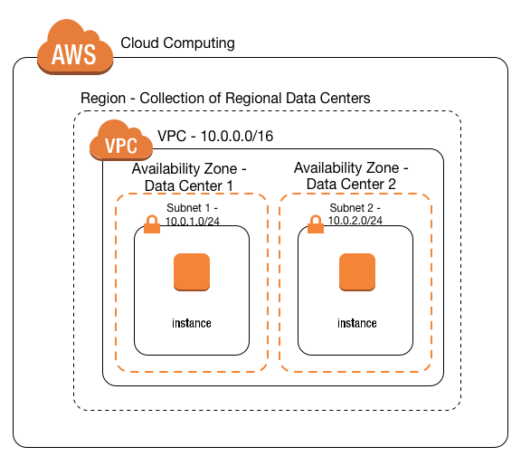
What is an Amazon Virtual private cloud (VPC)?
“A virtual network that closely resembles a traditional network that you’d operate in your own data center”

Slide 6
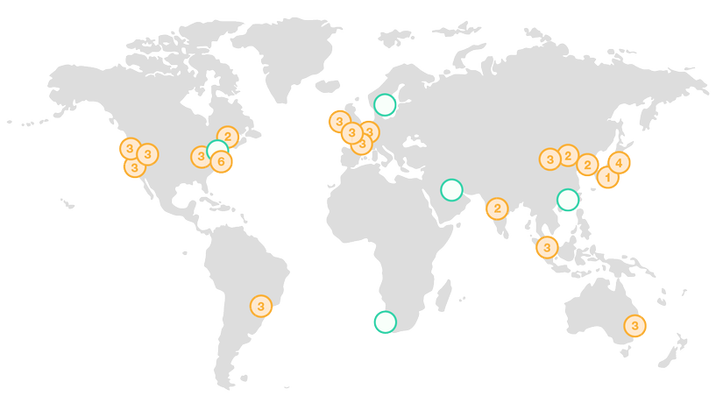
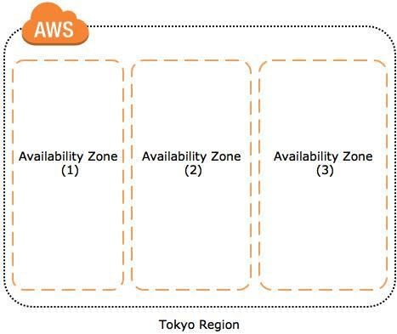
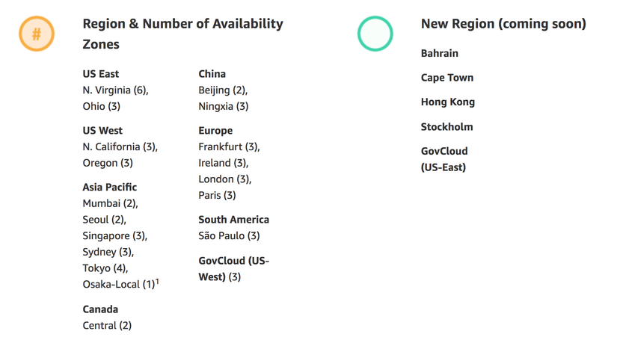
Some basic concepts
Region
AZ (Availibility Zone)

Slide 7
What’s in the VPC tool box?
VPC: User defined address space up to /16 (65,536 addresses)
Subnets: 200 user-defined subnets to /16
Route Tables: Define how traffic should be routed from/to each subnet
Access Control Lists: Stateless network filtering between subnets.
Internet Gateway: A logical device enabling traffic to be route to/from the public internet.
Managed NAT: Provide Network Address Translation to private instances for 10Gbps traffic.
Virtual Private Gateway: the Amazon end of a VPN connection.
Customer Gateway: The router at the customer end of a VPN connection.

Slide 8
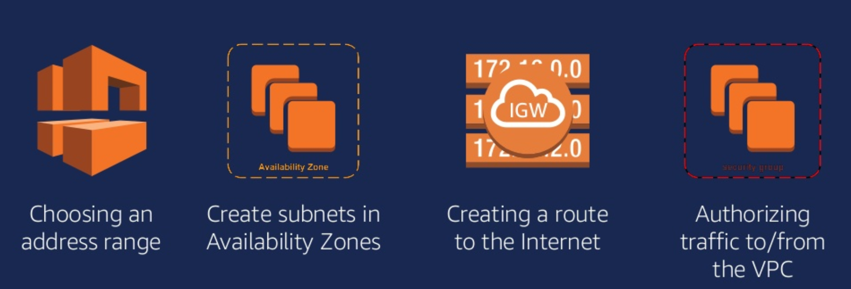
How to create an Internet-connected VPC step?

Slide 9
Picking for IP Space

Slide 10
CIDR notation review
CIDR range example:
172.31.0.0/16
1010 1100 0001 1111 0000 0000 0000 0000

Slide 11
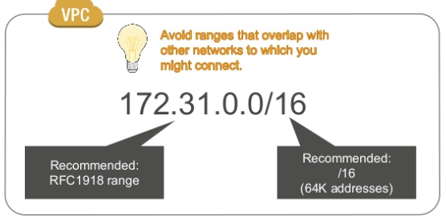
Choosing an IPv4 address range for your VPC

Slide 12
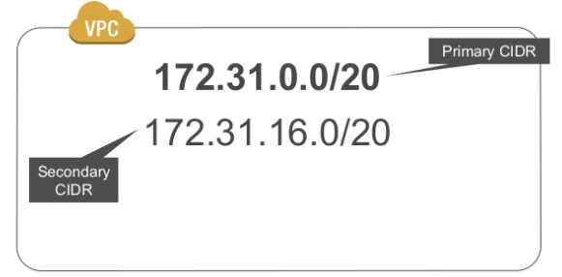
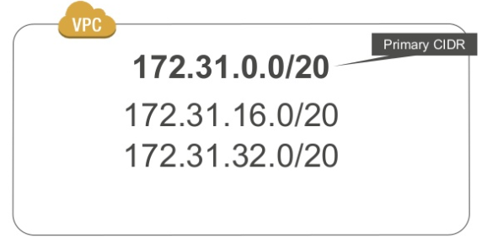
Adding a secondary IPv4 address range

Slide 13
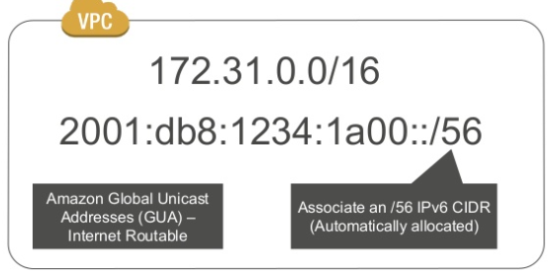
IPv6 in Amazon VPC-Dual-stack

Slide 14
Subnet

Slide 15

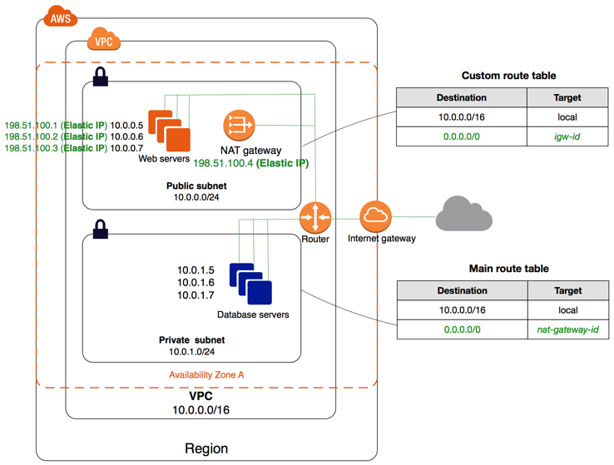
Public/Private Subnet

Slide 16
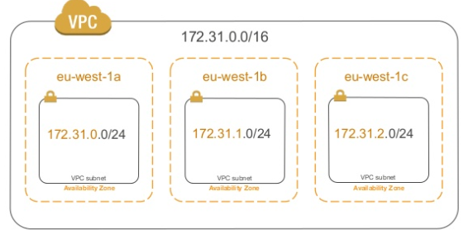
VPC subnets and Availability Zones

Slide 17
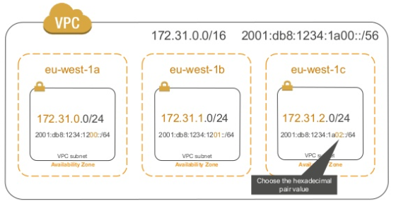
VPC subnets and Availability Zones– IPv6

Slide 18
VPC subnet recommendations
/16 VPC (64K IPv4 addresses)
/24 subnets (251 IPv4 addresses)
One subnet per Availability Zone
For IPv6:
/56 Allocated per VPC (Lots of addresses)
/64 subnets (256 Subnets)

Slide 19
Route to the Internet

Slide 20
Routing in your VPC
Route table contain rules for which packets go where
Your VPC has a default (main) route table
You can assign different other tables to different subnets

Slide 21
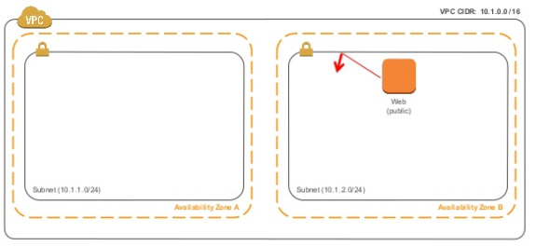
Public subnet routing

Slide 22
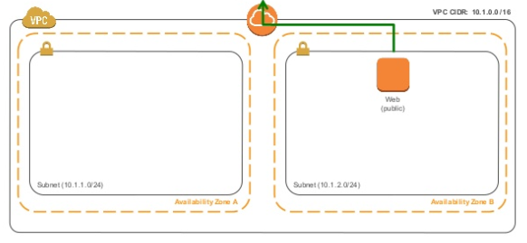
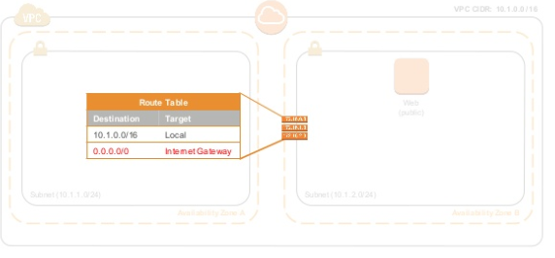
Public subnet routing-Internet Gateway

Slide 23
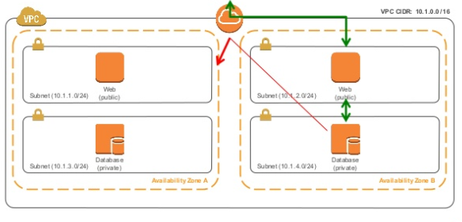
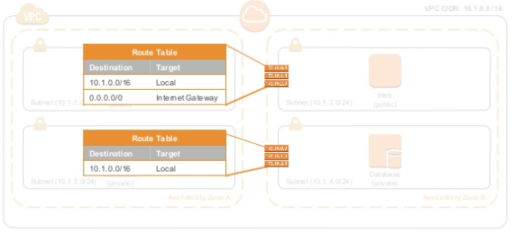
Private subnet routing

Slide 24
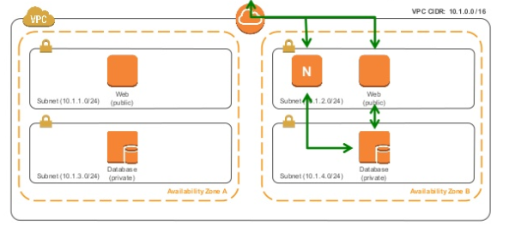
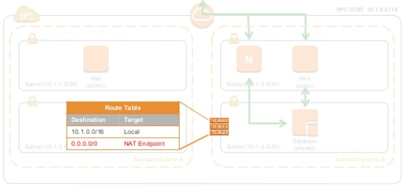
Private subnet routing-NAT gateway

Slide 25
Authorizing Traffic: Networks ACLs and Security Groups

Slide 26
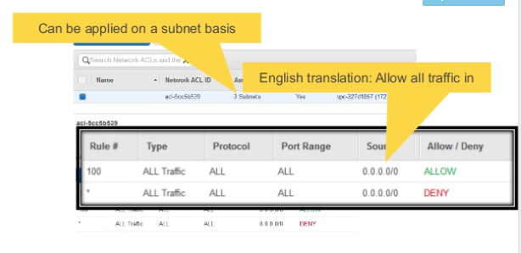
Network ACLs: Stateless firewalls

Slide 27
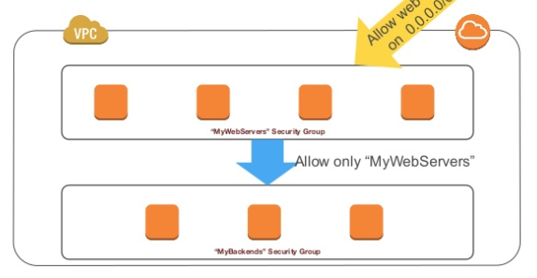
Security groups follow application structure

Slide 28
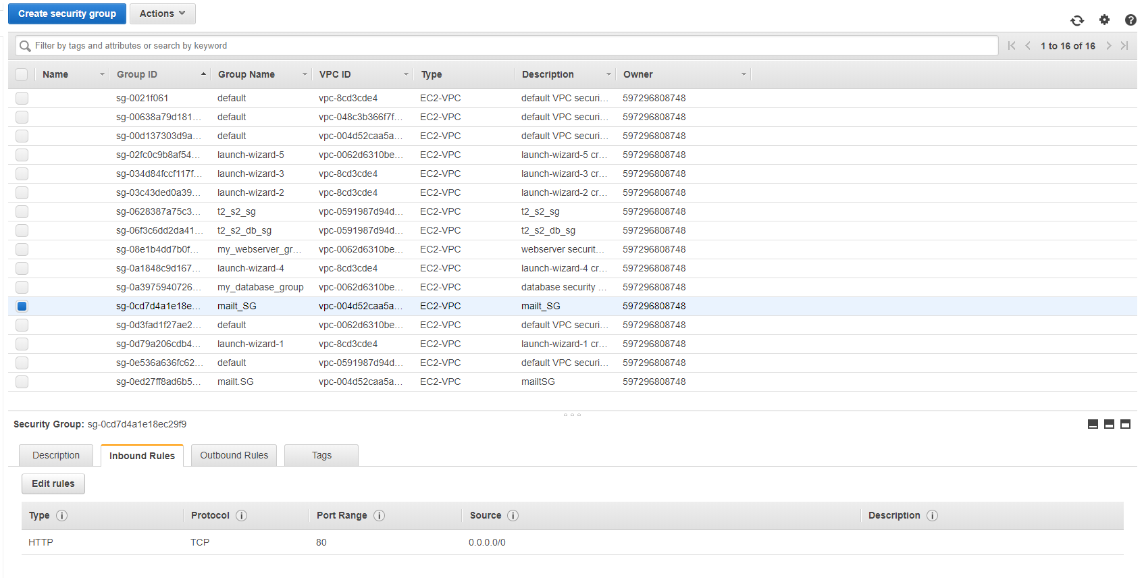
Security groups example: Web servers

Slide 29
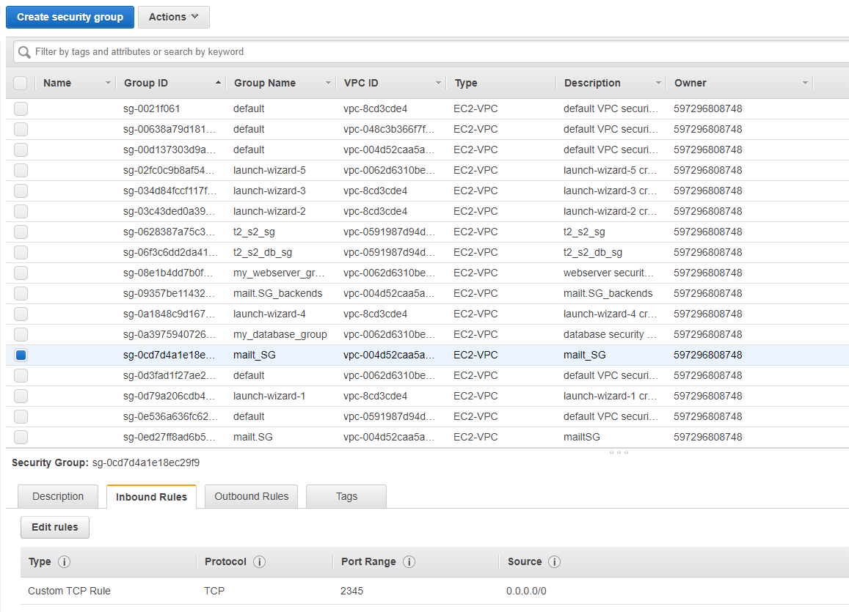
Security groups example: Backends

Slide 30
Security group in VPC: additional notes
Follow the Principle of Least Privilege
VPC allows creation of egress as well as ingress Security group rules.
Many application architectures lend themselves to a 1:1 relationship between security group (who can reach me) and IAM roles (what I can do).

Slide 31
Routing by subnet

Slide 32
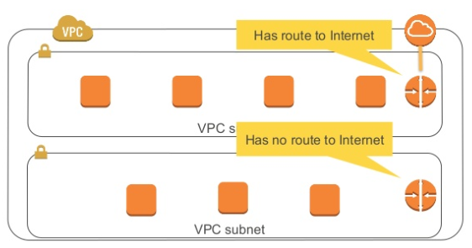
Routing by subnet

Slide 33
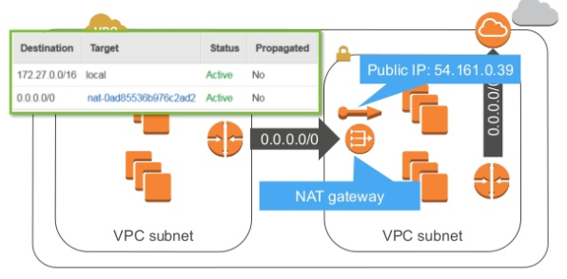
Outbound-only Internet access: NAT getway

Slide 34
IPv6 GUAs
For IPv6, Amazon VPC instance receive Global Unicast Address (GUA), which are Internet routable.
GUAs directly assigned to instance; there is no 1:1 NAT in the case of Internet access.
Using GUAs does not mean losing security or privacy-to have Internet access, you also need to have proper route tables, security groups and gateways.

Slide 35
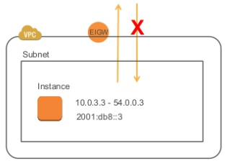
IPv6 Egress-only Internet Gateway
A new virtual device that provides egress-only Internet access over IPv6
No middle box to perform NAT, and no additional cost
No performance/availibility/connection limits

Slide 36
VPC Peering

Slide 37
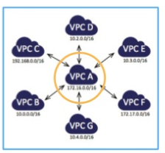
Connecting your VPCs (VPC Peering)
Creates a private network connection between any two VPCs in a region.
You can connect VPCs togother within a Region without having to:
Maintain all the VPN overhead between multiple VPCs.
Expose the destination VPC to the Internet and all that entails.
Including cross-account VPC Peering
Often used for Common/Core services
Authentication / Direction Services
Monitoring / Logging
Security Scanning
Remote administration

Slide 38
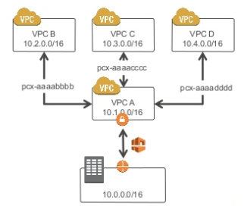
Common design- Shared Services VPC
Move shared services such as Active Directory, Logging, Monitoring and Service Buses to a shared services VPC (A)
None of the other VPCs can send traffic directly to each other-they must go through VPC A (=app isolation)
Only VPC A has direct network access to your data center via Directory Connect.
Routing table define which subnets are allowed to route over a peer connection.
Security Groups and NACLs still apply, and Security Groups in VPC. A can be defined to mutually trust the Security Groups in the other VPCs

Slide 39
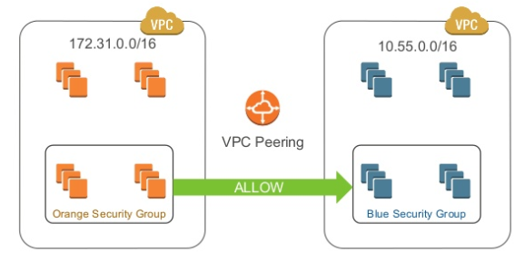
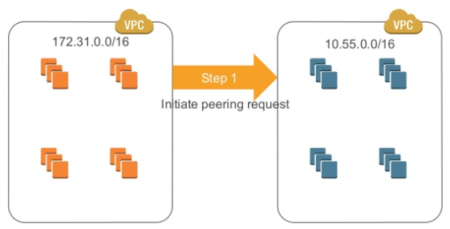
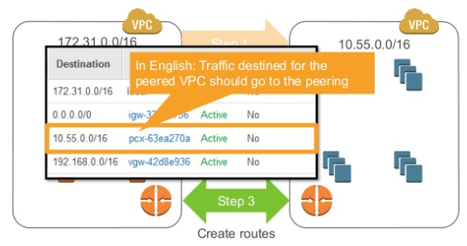
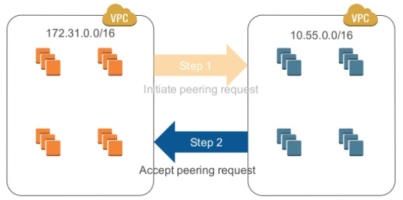
Security groups across peered VPCs

Slide 40
VPC Flow Logs

Slide 41
VPC Flow logs
Enables at the ENI, subnet or VPC level
Traffic data surfaced as “flow log records” per ENI
Data accumulated and published to CloudWatch Logs at ~10 minute intervals.
Exposed as CloudWatch log groups and streams
Normal CloudWatch Logs groups/streams with all related features.
Create custom CloudWatch metrics base upon log filtering
Create CloudWatch alarms based upon the new metrics
CloudWatch logs -> Amazon Kinesis stream integration

Slide 42
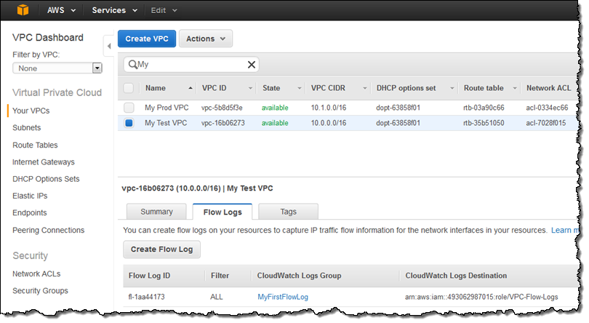
Flow log record(text, space-delimited)

Slide 43
VPC Endpoint

Slide 44
AWS Hardware VPN

Slide 45
AWS Direct Connect

Slide 46
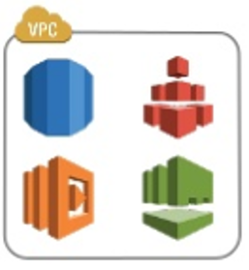
Place your screenshot here
Best practice for in VPC-AWS services.
Many AWS services support running in –VPC.
Use security groups for Least-Privilege network access.
For best avaibility, use multiple Avaibility Zones.
Ex:
Multi-zone RDS deployments
Use a zonal mount point for EFS access

Slide 47

Demo

Slide 48
THANKS!
Any questions?
Connect to github repository to read more detail: https://github.com/hueanmy/AWS-LEARNING

